Slide 1
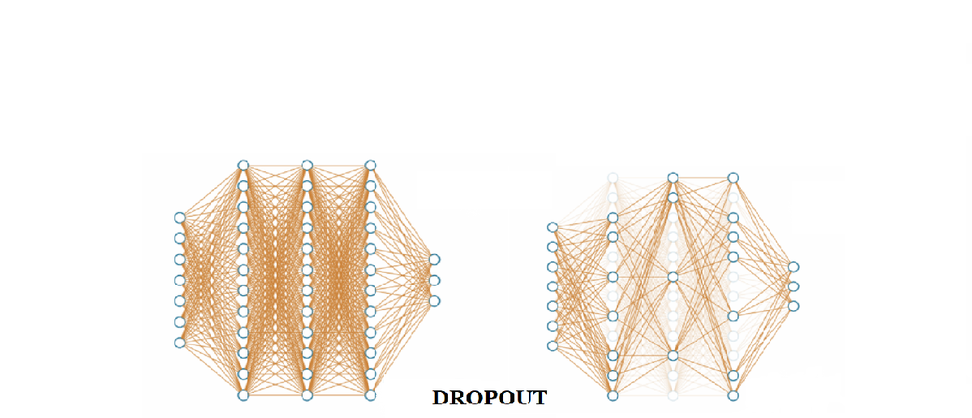
Book Chapter Review Neural Networks from Scratch in Python Chapter 15: Dropout
Group 05 - CSE424

Slide 2
Group Members
Md. Farhadul Islam
ID: 19201086
Dept. of CSE
Sarah Zabeen
ID: 19241004
Dept. of CSE

Slide 3
Book Information
Title: Neural Networks from Scratch in Python
Authors: Harrison Kinsley & Daniel Kukieła
Publisher: Harrison Kinsley

Slide 4
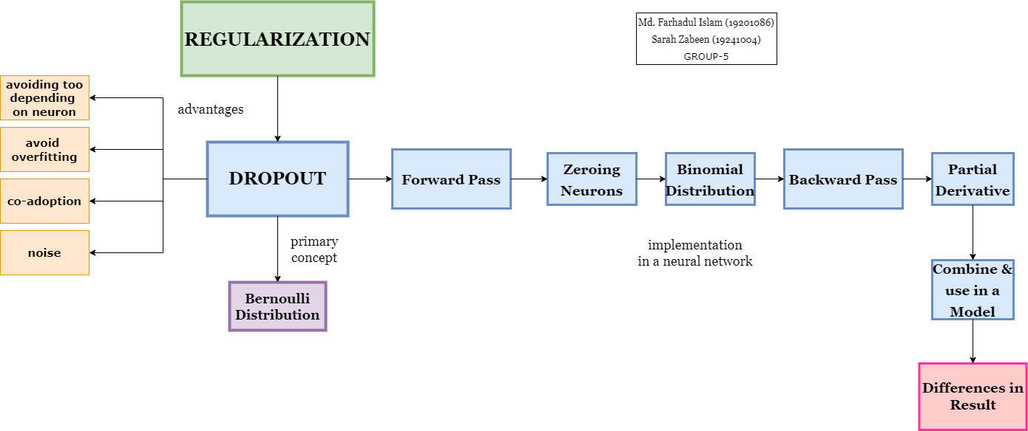
Concept Map

Slide 5
What is Dropout
Dropout (Dilution) is a regularization technique for reducing overfitting in artificial neural networks by preventing complex co-adaptations on training data. It is an efficient way of performing model averaging with neural networks. The term dilution refers to the thinning of the weights.

Slide 6
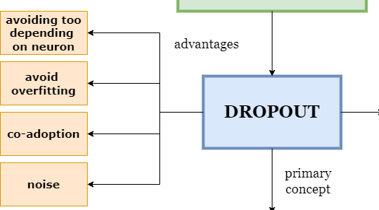
Why Use Dropout
To prevent a neural network from becoming too dependent on any neuron or for any neuron to be relied upon entirely in a specific instance
This process helps the model to avoid overfitting, especially in large neural networks.
Dropout can help with is co-adoption, which happens when neurons depend on the output values of other neurons and do not learn the underlying function on their own.
Can also help with noise and other perturbations in the training data as more neurons working together mean that the model can learn more complex functions.

Slide 7
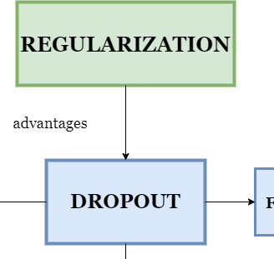
Regularization (Briefly)
Regularization is a technique used for tuning the function by adding an additional penalty term in the error function. The additional term controls the excessively fluctuating function such that the coefficients don't take extreme values.
Dropout is one of the most frequently used regularization techniques.

Slide 8
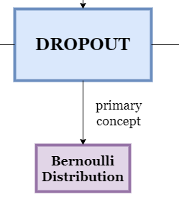
How does Dropout Work
The Dropout function works by randomly disabling neurons at a given rate during every forward pass, forcing the network to learn how to make accurate predictions with only a random part of neurons remaining.
We use a hyperparameter to inform the dropout layer of the number of neurons to disable randomly.
Dropout does not decrease the number of neurons used but instead zeroes their outputs. So, it does not make the training process twice as fast when half the neurons are disabled.

Slide 9
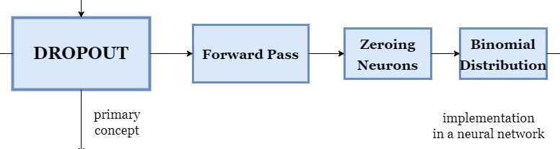
Forward Pass
The "forward pass" refers to calculation process, values of the output layers from the inputs data. It's traversing through all neurons from first to last layer.
We “turn off” neurons with a filter that is an array with the same shape as the layer output but filled with numbers drawn from a Bernoulli distribution.
A Bernoulli distribution is a binary (or discrete) probability distribution where we can get a value of 1 with a probability of p and value of 0 with a probability of q.

Slide 10
Forward Pass - Zeroing the Neurons
We have one hyperparameter for a dropout layer. This is a value for the percentage of neurons to disable in that layer. For example, if you chose 0.10 for the dropout parameter, 10% of the neurons will be disabled at random during each forward pass.
dropout_rate = 0.5
example_output = [0.27, -1.03, 0.67, 0.99, 0.05, -0.37, -2.01, 1.13, -0.07, 0.73]
>>> [0, -1.03, 0.67, 0.99, 0, -0.37, 0, 0, 0, 0.73]

Slide 11
Forward Pass - Bernoulli Distribution
Bernoulli Distribution is a special case of Binomial Distribution with a single trial. There are only two possible outcomes of a Bernoulli and Binomial distribution, namely success and failure.
If we consider a Bernoulli distribution as a special case of a Binomial distribution with n=1 and look at a list of available methods in NumPy, it turns out that there’s a much cleaner way to do this using numpy.random.binomial.
np.random.binomial(2, 0.5, size=10)
>>> array([0, 0, 1, 2, 0, 2, 0, 1, 0, 2])

Slide 12
Forward Pass - Making Dropout Layer
dropout_rate = 0.3
example_output = np.array([0.27, -1.03, 0.67, 0.99, 0.05, -0.37, -2.01, 1.13, -0.07, 0.73])
example_output *= np.random.binomial(1, 1-dropout_rate, example_output.shape)
>>> [ 0.27 -1.03 0.00 0.99 0. -0.37 -2.01 1.13 -0.07 0. ]
Note that our dropout rate is the ratio of neurons we intend to disable (q). Sometimes, the implementation of dropout will include a rate parameter that instead means the fraction of neurons we intend to keep (p). The dropout parameter in deep learning frameworks, TensorFlow and Keras, represents the neurons we intend to disable.

Slide 13
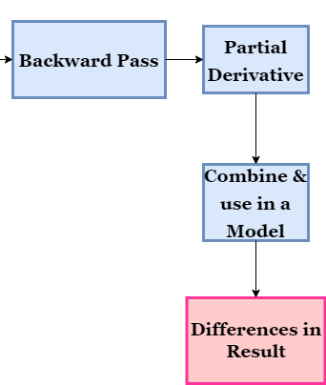
Backward Pass
The last missing piece to implement dropout as a layer is a backward pass method.
We need to calculate the partial derivative of the dropout operation.

Slide 14


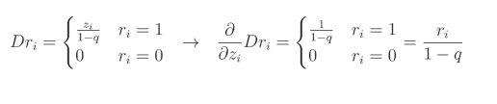
Backward Pass - Partial Derivative
When the value of element ri equals 1, its function and derivative becomes the neuron’s output, z, compensated for the loss value by 1-q, where q is the dropout rate, as we just described i n eq. (i).
That’s because the derivative with respect to z of z is 1, and we treat the rest as a constant. When ri = 0 in eq. (ii).
That’s because we are zeroing this element of the dropout filter, and the derivative of any constant value (including 0) is 0. Let’s combine both cases and denote Dropout as Dr in eq. (iii)
(i)
(ii)
(iii)

Slide 15
Results
Technique | Epoch | Accuracy | Loss | Learning Rate | Validation Accuracy | Validation Loss
L2 Regularization | 10,000 | 91.8% | 0.253 | 0.019 | 92.0% | 0.256
Dropout | 10,000 | 85.9% | 0.468 | 0.033 | 85.7% | 0.379

Slide 16
Conclusion

